Slide 1

7th Grade Math
Unit 9, Lesson 7 Equivalent Linear Expressions Volume 2, pg. 70

Slide 2


Benchmark
MA.7.AR.1.2
Determine whether two linear expressions are equivalent.
volume 2, pg. 70

Slide 3
Integrated Mathematical Thinking and Reasoning Standards
MA.K12.MTR.1.1 Actively participate in effortful learning both individually and collectively.
MA.K12.MTR.4.1 Engage in discussions that reflect on the mathematical thinking of self and others.
volume 2, pg. 70

Slide 4

Learning Target
I can verify using substitution that linear expressions are equivalent.
volume 2, pg. 70

Slide 5

Warm-Up
volume 2, pg. 71

Slide 6
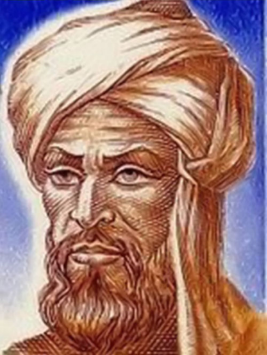
9.7.1 Warm-Up: Origins of Algebra
The word algebra comes from the Arabic word الجبر, or al-jabr, which means, “the restoring of broken parts.” The word algebra comes from the title of a book written by a Persian mathematician named Muhammad ibn Musa al-Khwarizmi in the 9th century.
Based on what you know about algebraic expressions and equations, explain why you think this meaning of the Arabic word makes sense to describe algebra.
volume 2, pg. 71

Slide 7

Refresher
volume 2, pg. 71

Slide 8

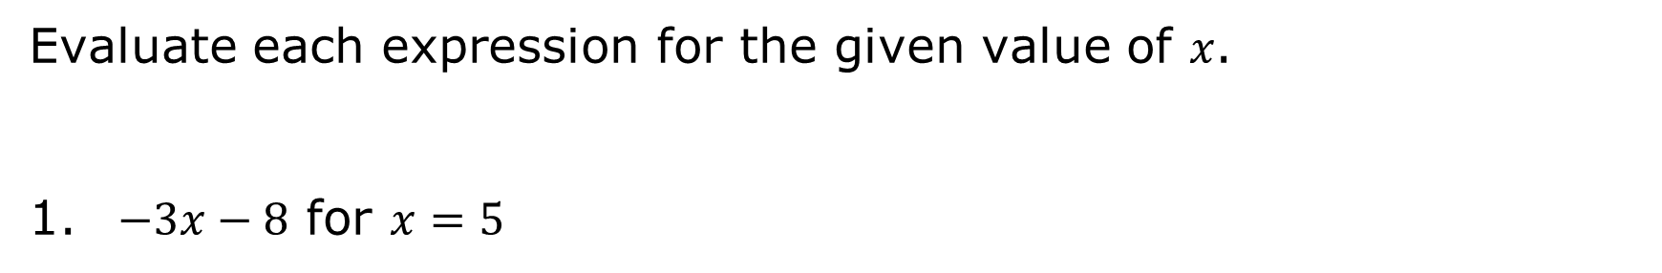
9.7.2 Refresher: Evaluating Algebraic Expressions
Evaluate each expression for the given value of 𝑥.
$−3x−8$ for $x=5$
volume 2, pg. 71

Slide 9
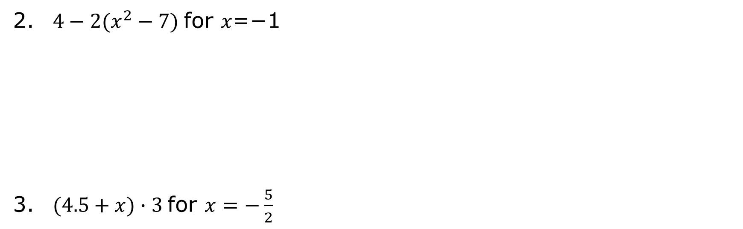
$4−2(x^{2}−7)$for 𝑥=−1
$(4.5+x)∙3$for $x=−\frac{5}{2}$
volume 2, pg. 71

Slide 10

Collaboration
volume 2, pg. 72

Slide 11

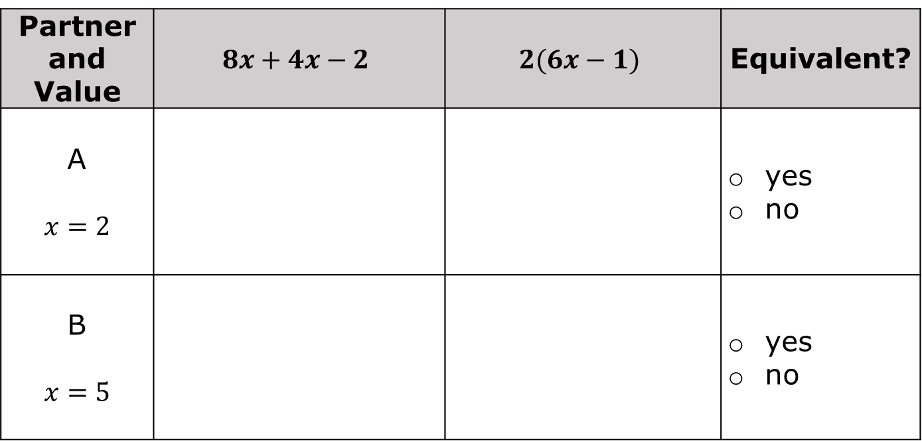
9.7.3 Collaboration: Evaluating Equivalent Expressions Using Substitution
With your partner, complete the table by choosing who will be Partner A or Partner B to determine if the expressions are equivalent.
Partner and Value | $$8x+4x−2$$ | $$2(6x−1)$$ | Equivalent?
A $$x=2$$ |  |  | yes no
B $$x=5$$ |  |  | yes no
volume 2, pg. 72

Slide 12
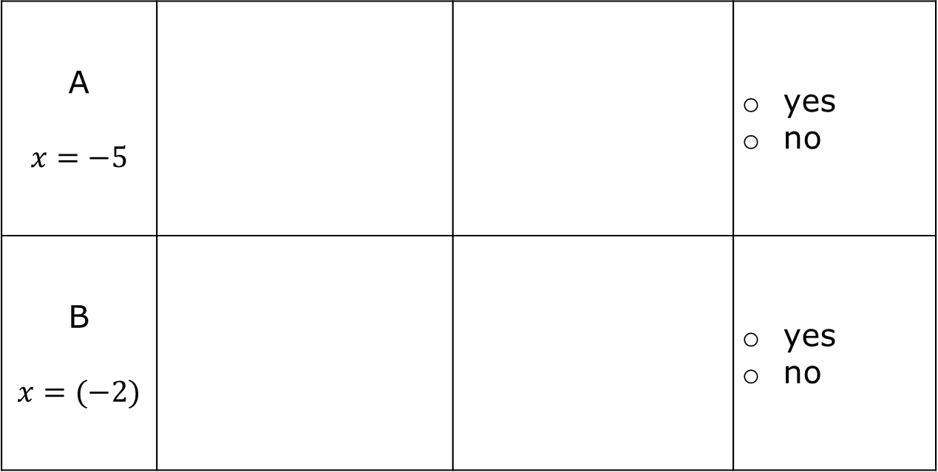
A $$x=−5$$ |  |  | yes no
B $$x=(−2)$$ |  |  | yes no
volume 2, pg. 72

Slide 13
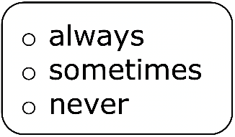
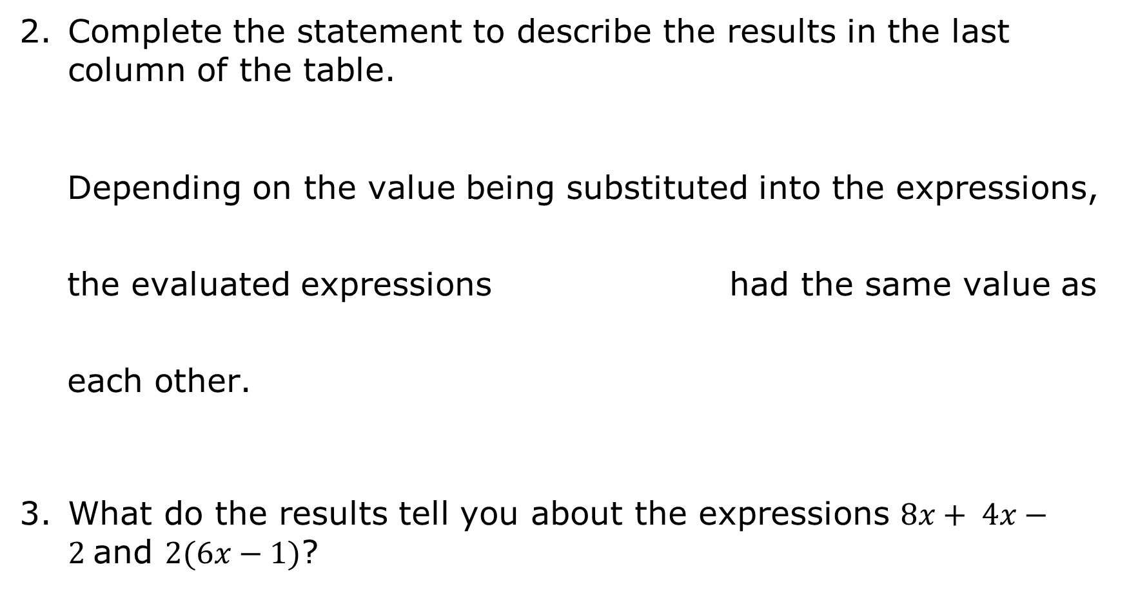
Complete the statement to describe the results in the last column of the table.
Depending on the value being substituted into the expressions, the evaluated expressions had the same value as each other.
What do the results tell you about the expressions $8x+ 4x−2$and $2(6x−1)$?
volume 2, pg. 72

Slide 14
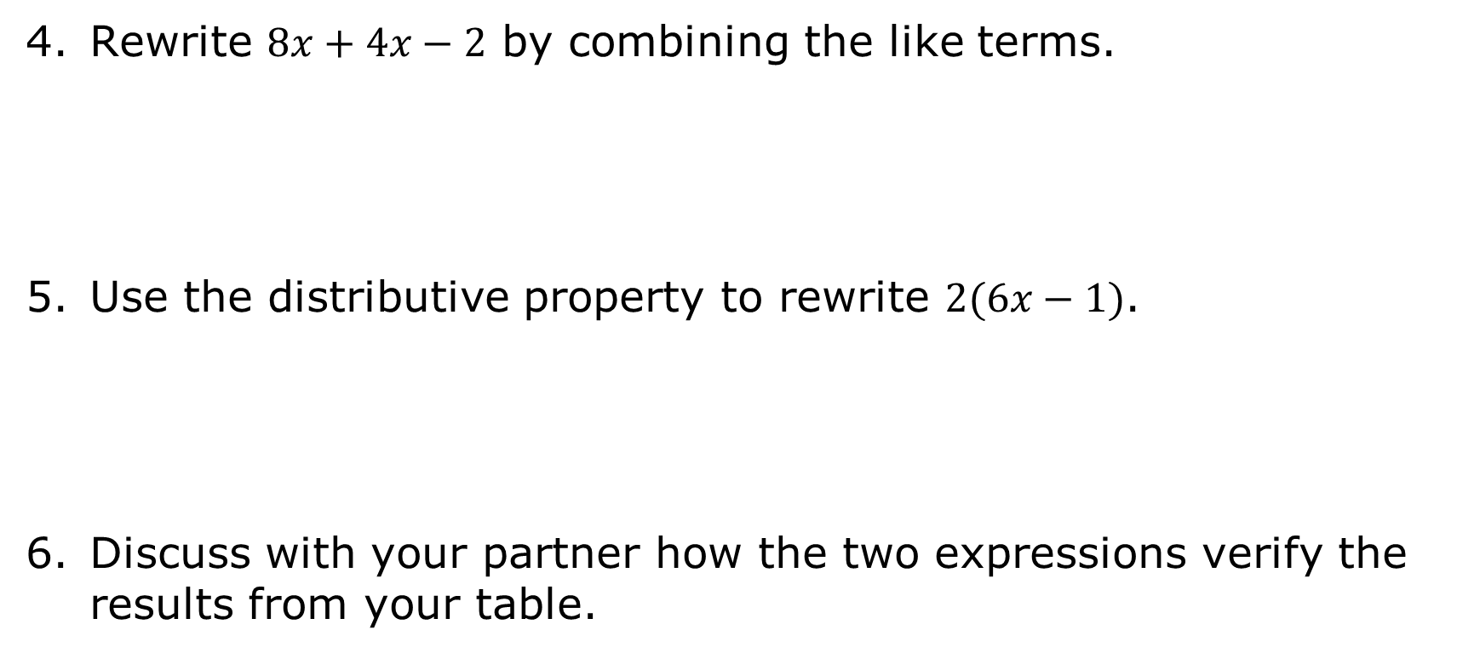
Rewrite $8x+4x−2$ by combining the like terms.
Use the distributive property to rewrite $2(6x−1)$.
Discuss with your partner how the two expressions verify the results from your table.
volume 2, pg. 72

Slide 15

Guided Instruction
volume 2, pg. 73

Slide 16

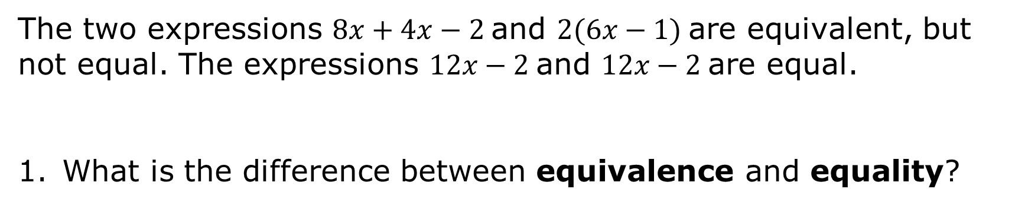
9.1.3 Guided Instruction: Determining Equivalent Expressions Using Substitution
The two expressions $8x+4x−2$and $2(6x−1)$are equivalent, but not equal. The expressions $12x−2$and $12x−2$are equal.
What is the difference between equivalence and equality?
Algebraic expressions are equivalent if they have different terms but are equal when evaluated using the same value for the variables. Algebraic expressions are equal if they have the same terms and operations.
volume 2, pg. 73

Slide 17
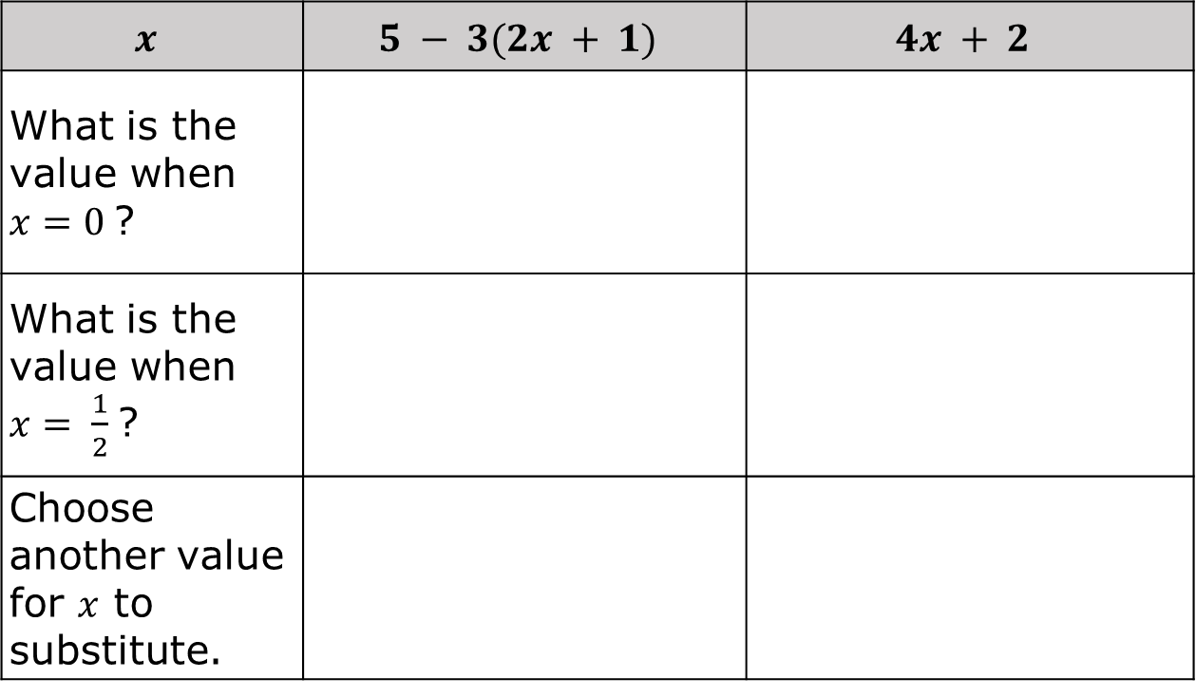
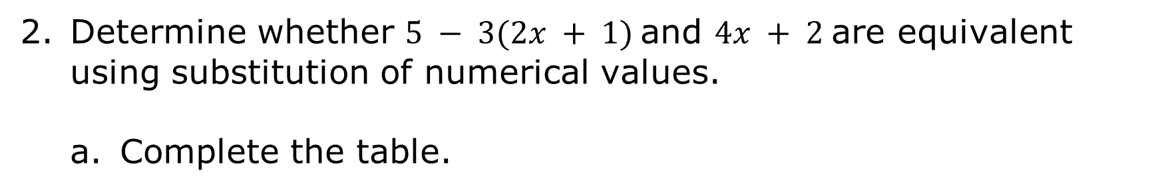
Determine whether $5 − 3(2x + 1)$and $4x + 2$are equivalent using substitution of numerical values.
Complete the table.
$$x$$ | $$5 − 3(2x + 1)$$ | $$4x + 2$$
What is the value when $x=0$?
What is the value when $x= \frac{1}{2}$?
Choose another value for $x$ to substitute.
volume 2, pg. 73

Slide 18
Explain if the expressions are equivalent.
volume 2, pg. 73

Slide 19

Explain why the expressions were equal when “$0$” was substituted for 𝑥.
Discuss with your partner the advantages and disadvantages of using “$0$” to substitute for a variable to check for equivalence.
volume 2, pg. 74

Slide 20
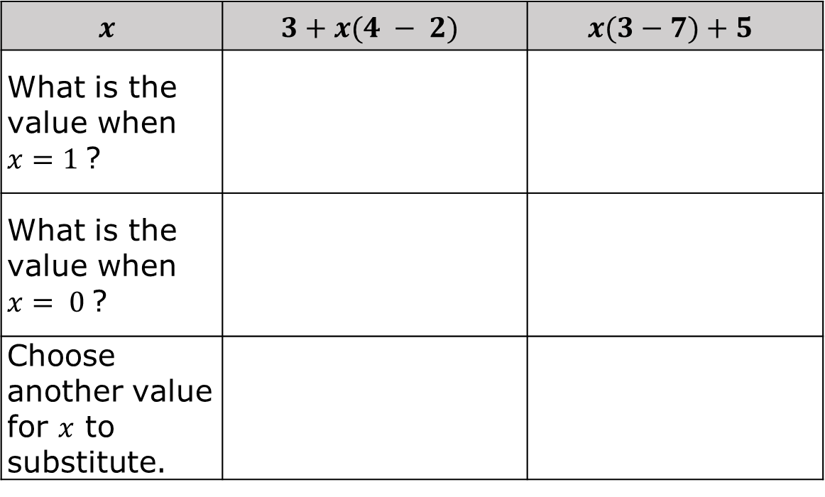
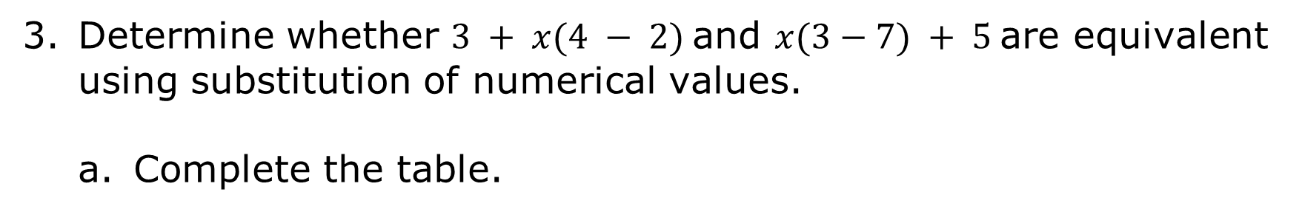
Determine whether $3 + x(4 − 2)$and $x(3−7) + 5$are equivalent using substitution of numerical values.
Complete the table.
$$x$$ | $$3+x(4 − 2)$$ | $$x(3−7)+5$$
What is the value when $x=1$?
What is the value when $x= 0$?
Choose another value for $x$ to substitute.
volume 2, pg. 74

Slide 21
How many values are best to use when substituting values in for the variable to check for equivalency?
volume 2, pg. 74

Slide 22

Guided Practice
volume 2, pg. 75

Slide 23

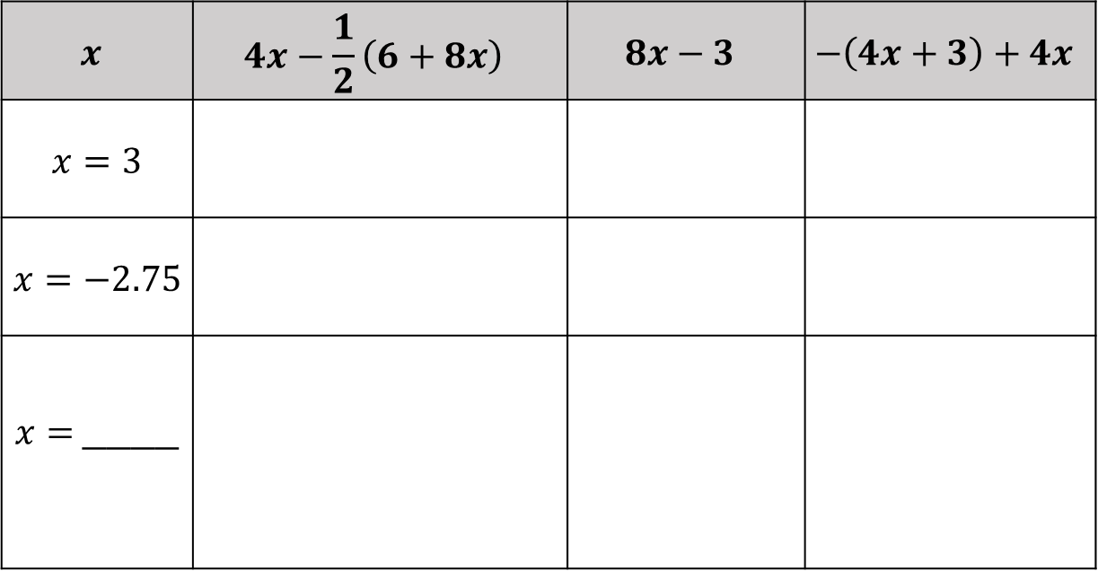
9.7.5 Guided Practice: Determining Equivalent Expressions Using Substitution
Consider the three expressions below. Determine whether the expressions are equivalent by substituting the given value of 𝑥.
Complete the table.
$$x$$ | $$4x−\frac{1}{2}\left(6+8x\right)$$ | $$8x−3$$ | $$−\left(4x+3\right)+4x$$
$$x=3$$
$$x=−2.75$$
$x=$____
volume 2, pg. 75

Slide 24
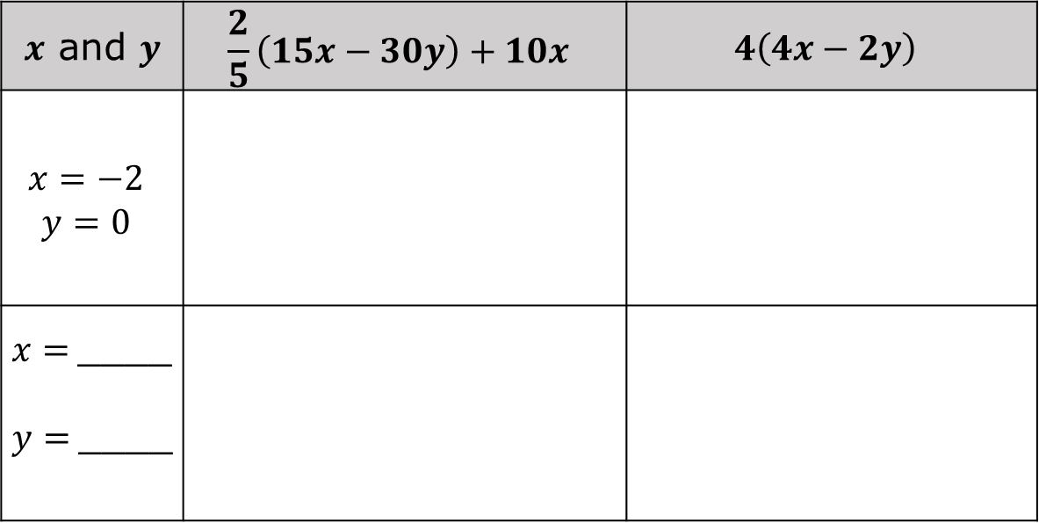
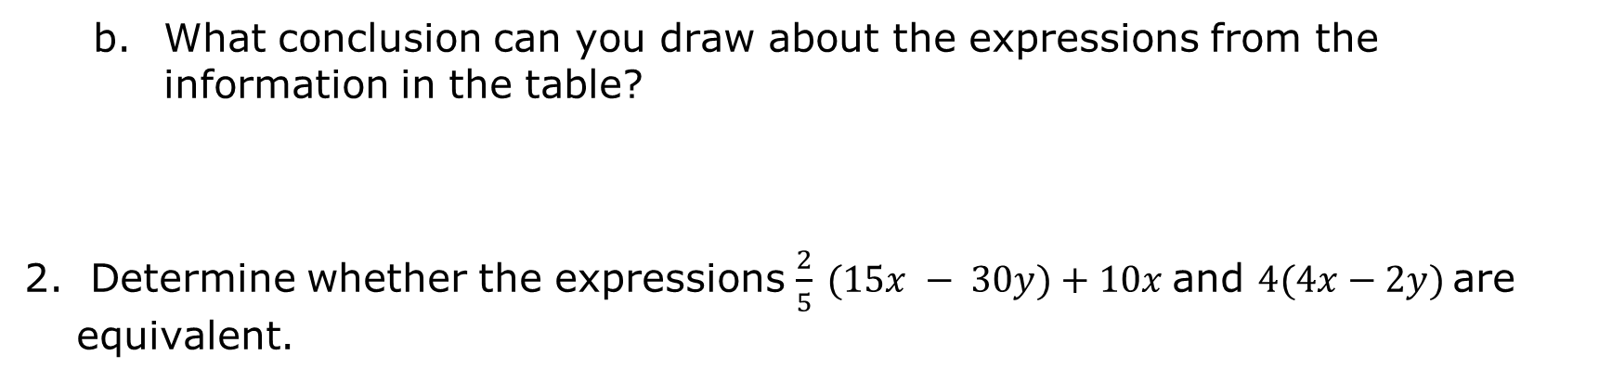
What conclusion can you draw about the expressions from the information in the table?
Determine whether the expressions $\frac{2}{5} (15x − 30y)+10x$and $4(4x−2y)$are equivalent.
$x$ and $y$ | $$\frac{2}{5}\left(15x−30y\right)+10x$$ | $$4\left(4x−2y\right)$$
$$x=−2$$ $$y=0$$
$x=$____ $y=$____
volume 2, pg. 75

Slide 25

Your Turn
volume 2, pg. 76

Slide 26
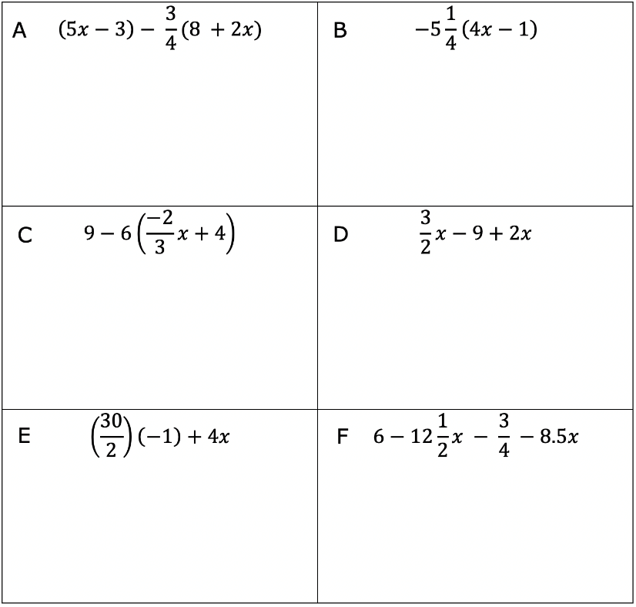
9.7.6 Your Turn!
Determine which expressions are equivalent by substituting the same values for the variable.
volume 2, pg. 76

Slide 27
Complete each statement using the expressions from the table.
_________________ is equivalent to _________________
_________________ is equivalent to _________________
_________________ is equivalent to _________________
volume 2, pg. 76

Slide 28

Wrap-Up
volume 2, pg. 76

Slide 29
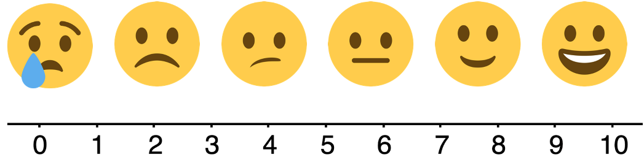
9.7.7 Wrap-Up: Reflection
Rate yourself using the scale below on today’s learning target.
I can verify using substitution that linear expressions are equivalent.
Write an explanation of why you rated yourself where you did.
volume 2, pg. 76

